Slide 1
Data Structure Lab 5 Stacks CSCI207

Slide 2
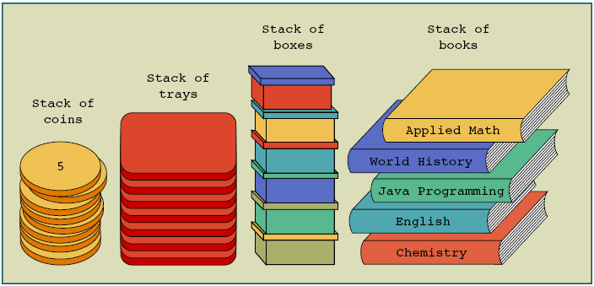
Stacks

Slide 3
Stacks
Stacks are also called Last In First Out (LIFO) data structures
Operations performed on stacks
Push: adds an element to the stack
Pop: removes an element from the stack
Peek: looks at the top element of the stack

Slide 4
Stack Representation LIFO
Clear()
Pop()
S
Peek()?
Push(10)
Push(8)
Push(5)
8
10
8
5
Notes:
Last in first out

Slide 5
Let’s implement
First we need to create class stack that has members:
Size : int → the max size you need
Top : int → the last element in the stack
List : array of int values(or any data type we need)
Default constructor
Set size = 100
Set top = -1 → that refer to the stack is empty
Create list of size 100

Slide 6
Let’s implement
Parameterized constructor that take size parameter
Set size = the size you got from parameter
Set top = -1 → that refer to the stack is empty
Create list it's size that you got from parameter
Initialization function → to initialize all element of list
Push function → to add new element
Pop function → return the last element and delete it
Peek function → just return last element
Clear function → remove all element

Slide 7
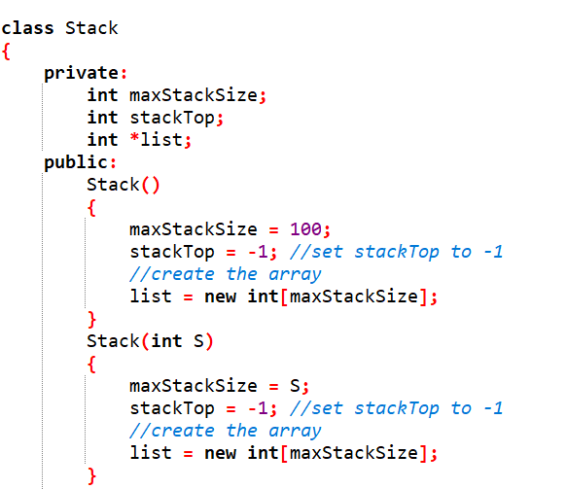
Let’s implement

Slide 8
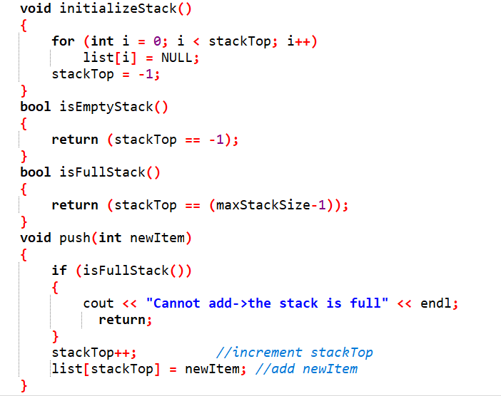
Let’s implement

Slide 9
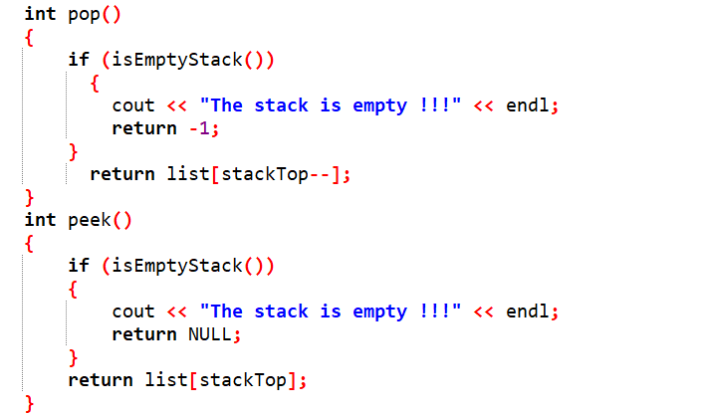
Let’s implement

Slide 10
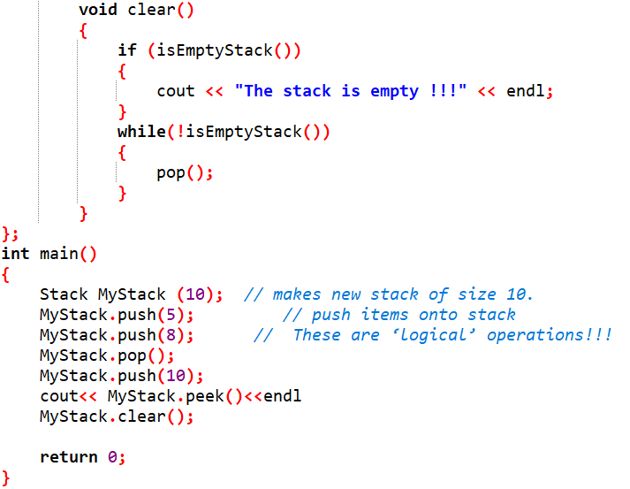
Let’s implement

Slide 11
Stack using linked list
Drawbacks of Implementing a Stack Using Arrays
Fixed Size Limitation
Inefficient Memory Management
Costly Resizing Operations
Must know max number of values at compile time
Arrays hold data of the same data type

Slide 12

Stack using linked list
Each item(node) in stack contains :-
A piece of data (any type)
Pointer to the previous node in the stack

Slide 13
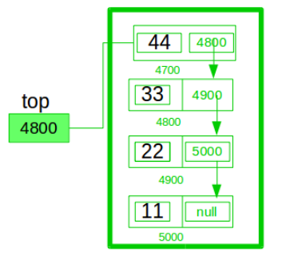
Stack using linked list
Pointer of the first node point to Null
Each node contain the address of the previous node
Top pointer contain the address of the last node in the stack

Slide 14
Stack Operations
Push: adds an element to the stack
Pop: removes an element from the stack
Peek: looks at the top element of the stack
Check the Implementation.cpp file

Slide 15
Task : DECIMAL TO BINARY CONVERTER
Implement a function that takes input parameters (decimal number) and works on it using Stack to convert it into a binary number.
EX: to convert 8 to binary
8 /2 →4 with reminder 0
4/2 → 2 with reminder 0
2/2 → 1 with reminder 0
1/2 → 0 with reminder 1
So 8 become 1000
S
1
0
0
0

Slide 16
THANK YOU

